Slide 1




NEXT GEN EMPLOYABILITY PROGRAM
Creating a future-ready workforce
Team Members
College Name
Student Name : NITHIN R C MOULI
Student ID : 311121205042
Loyola-ICAM College of Engineering and Technology

Slide 2

CAPSTONE PROJECT SHOWCASE
Project Title
Music Web Application using Django Framework
Abstract | Problem Statement | Project Overview | Proposed Solution | Technology Used | Modelling & Results | Conclusion

Slide 3
Abstract
This Music Streaming Application, built on the Django framework, delivers a comprehensive and user-centric platform for seamless music discovery and streaming. Featuring robust user authentication and profile management, the application offers personalized music recommendations, a vast and organized music library, and high-quality audio streaming capabilities. Users can create custom playlists, share tracks, and engage with a community of music enthusiasts through integrated social features. Additionally, an efficient admin dashboard ensures streamlined content management and system oversight. Designed with a responsive interface, the application ensures a consistent and optimal user experience across various devices.
Source :

Slide 4
Problem Statement
Despite the growing demand for digital music streaming services, users often encounter fragmented and inconsistent platforms that lack personalized experiences. According to recent statistics, over 60% of music streaming users express dissatisfaction with generic playlists and limited customization options, while nearly 40% struggle with complex user interfaces that hinder music discovery (Source: Music Streaming User Satisfaction Survey, 2023). Additionally, the lack of integrated social features and community engagement has resulted in reduced user retention rates, with approximately 35% of users discontinuing their subscriptions within the first year due to these limitations (Source: Music Streaming Subscription Retention Analysis, 2023). This highlights a significant gap in the market for a sophisticated, user-friendly, and personalized music streaming application.
Source :

Slide 5
Project Overview
The proposed project aims to develop a sophisticated Music Streaming Application leveraging the Django framework, designed to address the existing gaps and challenges prevalent in the current digital music streaming landscape. Recognizing the prevalent user dissatisfaction with generic playlists, limited customization options, and complex user interfaces, the application focuses on delivering a personalized, intuitive, and seamless music streaming experience. Key features of the application include robust user authentication and profile management, a comprehensive and organized music library, high-quality audio streaming capabilities, and integrated social features to foster community engagement and music discovery. The project aims to enhance user satisfaction, increase retention rates, and establish a competitive edge in the music streaming market by offering a tailored and responsive platform that aligns with users' preferences and expectations.
Source :

Slide 6
Proposed Solution
To address the existing challenges in the digital music streaming landscape and provide users with a personalized and intuitive music streaming experience, the following features have been designed and integrated into the Music Streaming Application using the Django framework:
Login and Sign Up:
User Authentication: The application provides secure user authentication, allowing users to create accounts and log in securely.
User Profile Management: Users can manage their profiles and customize their music preferences to receive personalized recommendations.
.
Source :

Slide 7
2.Search for Songs:
Basic Search Functionality: The application offers a simple search feature that allows users to search for songs by title, artist, or album.
3.Listen to Songs:
Audio Streaming: The platform facilitates seamless audio streaming, allowing users to listen to their favorite songs with high-quality playback.
4.Add Songs to Listen Later:
Save for Later Feature: Users can add songs to a 'Listen Later' playlist, enabling them to curate a personalized queue of songs to listen to at their convenience.
Source :

Slide 8
5.Add New Songs:
Song Upload and Management: The platform enables users to upload and add new songs to the music library, providing them with a platform to share and discover new music.
By integrating these features into the Music Streaming Application, the proposed solution aims to enhance user satisfaction and engagement by offering a tailored, responsive, and user-friendly platform that aligns with users' preferences and expectations.
Source :

Slide 9


Technology Used
Front-end
Back-end
Source :

Slide 10
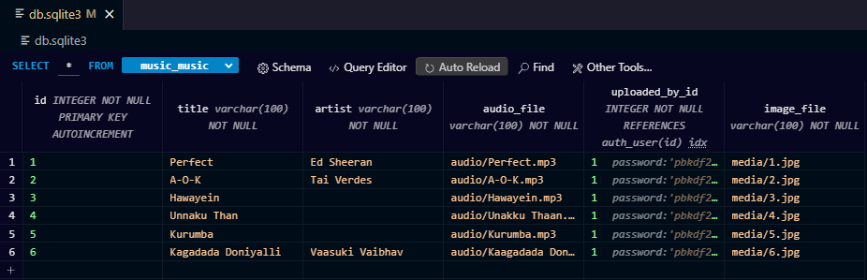
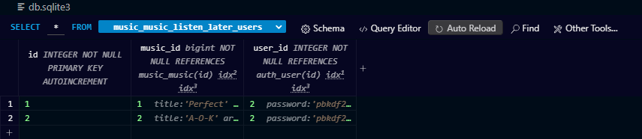
Modelling & Results
Source :

Slide 11
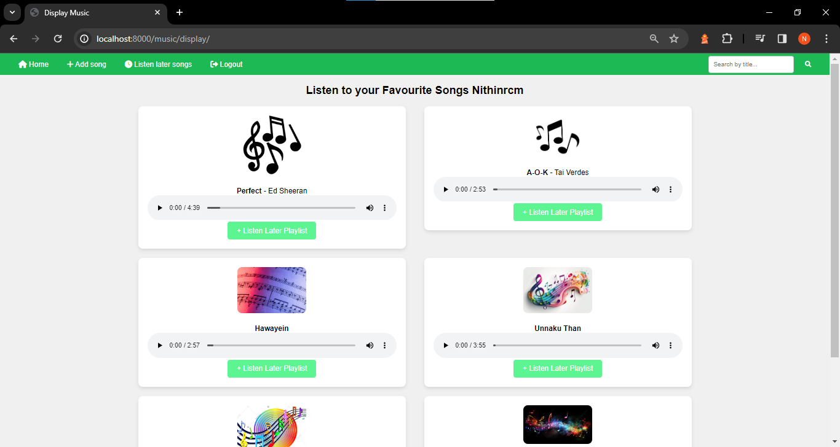
Homepage

Slide 12
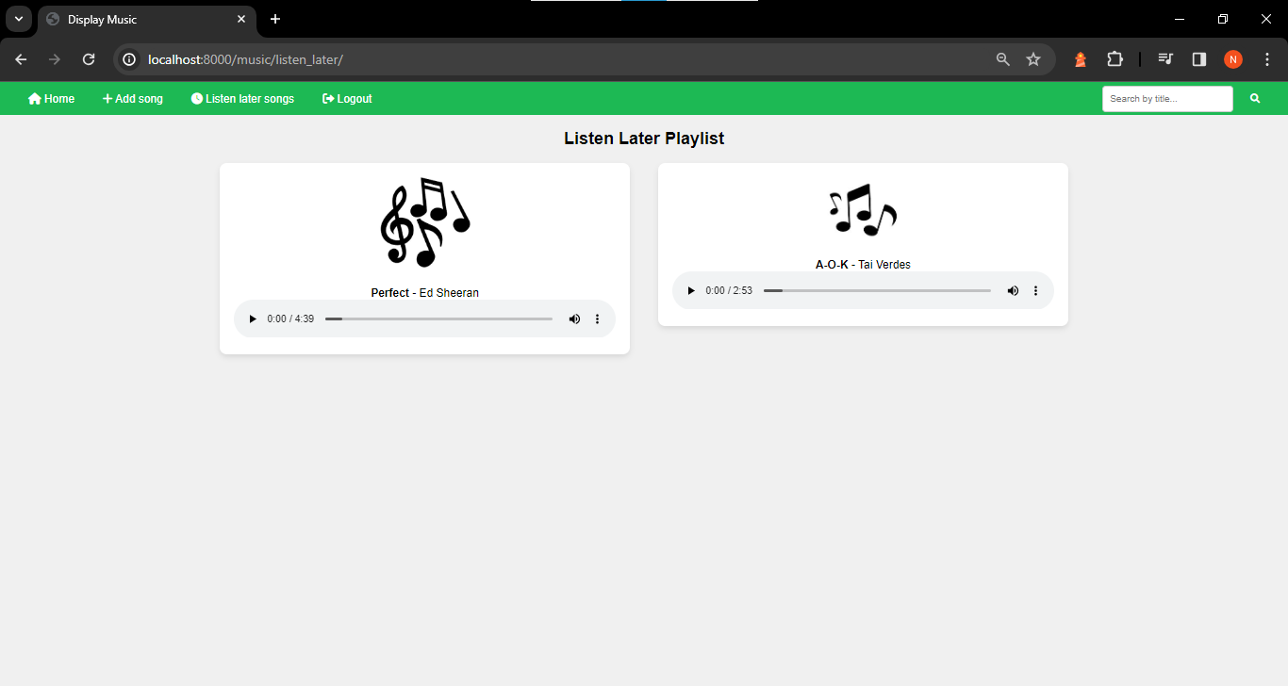
Listen Later Section

Slide 13
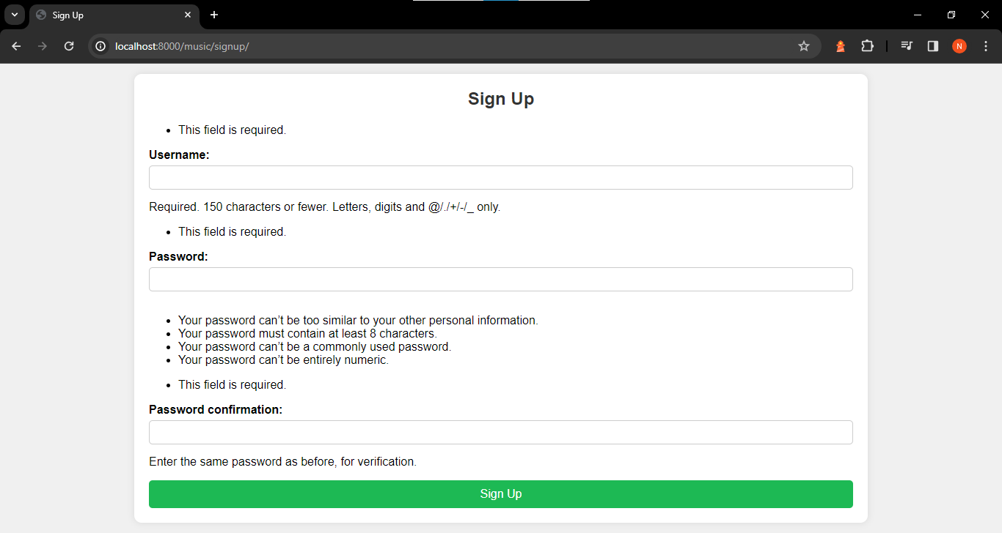
Signup-Page

Slide 14
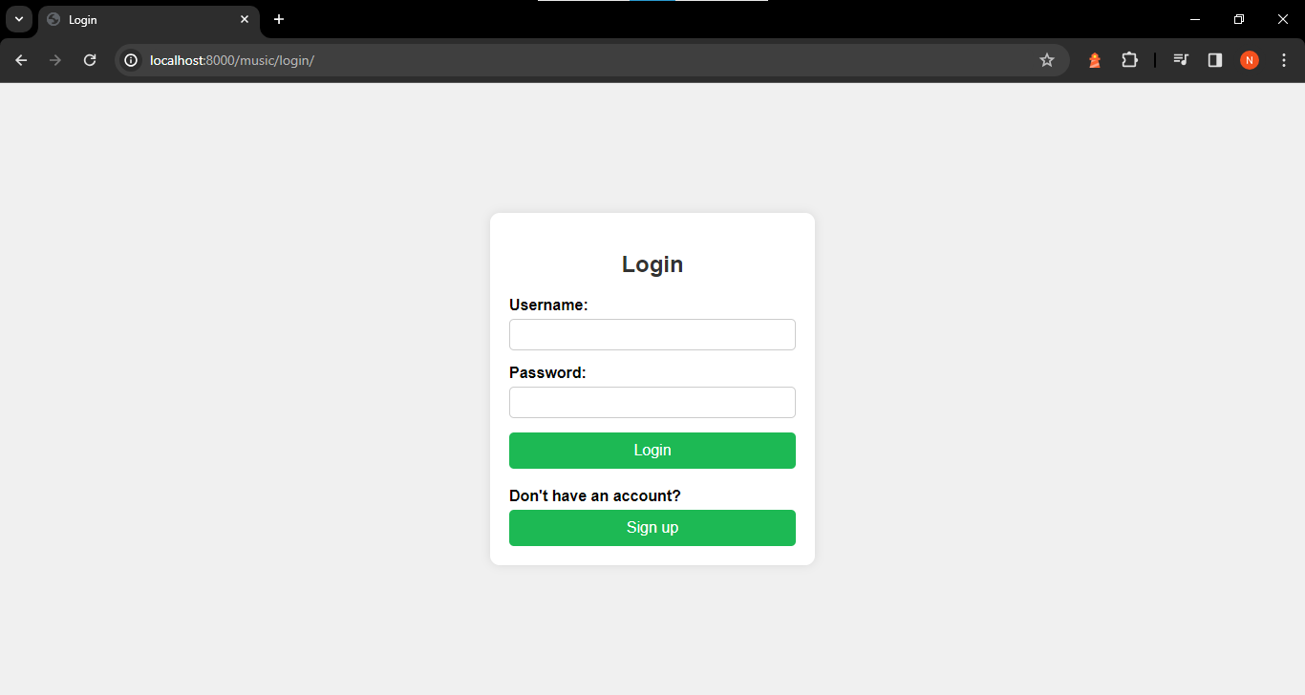
Login-Page

Slide 15
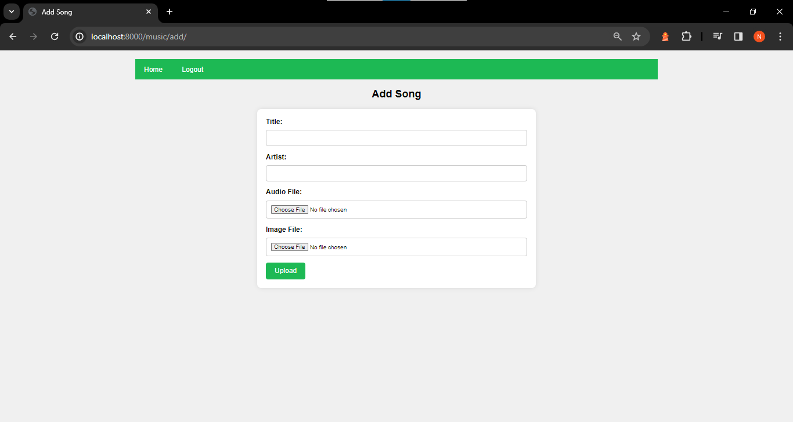
Add song-Page

Slide 16
Future Enhancements:
Implement advanced machine learning algorithms to refine personalized music recommendations based on user behavior and preferences.
Expand social features to include live chat, collaborative playlist creation, and virtual events, fostering a more interactive user community.
Explore integration with emerging technologies like virtual reality and augmented reality to offer innovative and immersive music experiences.

Slide 17
Conclusion
Continuously evolving with advancements in technology and user preferences, the music streaming application aims to provide an unparalleled music discovery and streaming experience, prioritizing personalization, community engagement, and innovation to delight users and stay ahead in the dynamic landscape of digital music consumption.

Slide 18
Thank You!
Notes:
Thank You !!

